Slide 1




PRESENTED BY
-Adhm Ahmed Ali

Slide 2





ENERGY UTILITY CUSTOMER BI PROJECT
From OLTP source to SSAS cube — a complete Microsoft BI stack built on SQL Server, SSIS, SSAS, and Power BI.

Slide 3

AGENDA
THE BUSINESS CHALLENGE
PROJECT OVERVIEW
FULL STACK ARCHITECTURE
HOW THE SYSTEM WORKS
OLTP Source Database
OLTP SOURCE ERD
Data Warehouse
DW SCHEMA
BILLING DATA MART
SSIS ETL PIPELINE
SSAS OLAP CUBE
DASHBOARDS
AUTOMATION & SCHEDULING
NEXT STEPS

Slide 4

THE BUSINESS CHALLENGE
A power utility needs to understand how customers consume energy, when they pay, and where collection risk lives.
The utility collects millions of transactional records but has no consolidated view for analysis. Questions that should take seconds take hours.
System Objectives
Understand energy consumption patterns by time, customer type, and geography
Track billing status — paid, overdue, disputed — in real time
Enable demand-response pricing and peak-load analysis
Give finance a clean collections dashboard with zero SQL queries

Slide 5
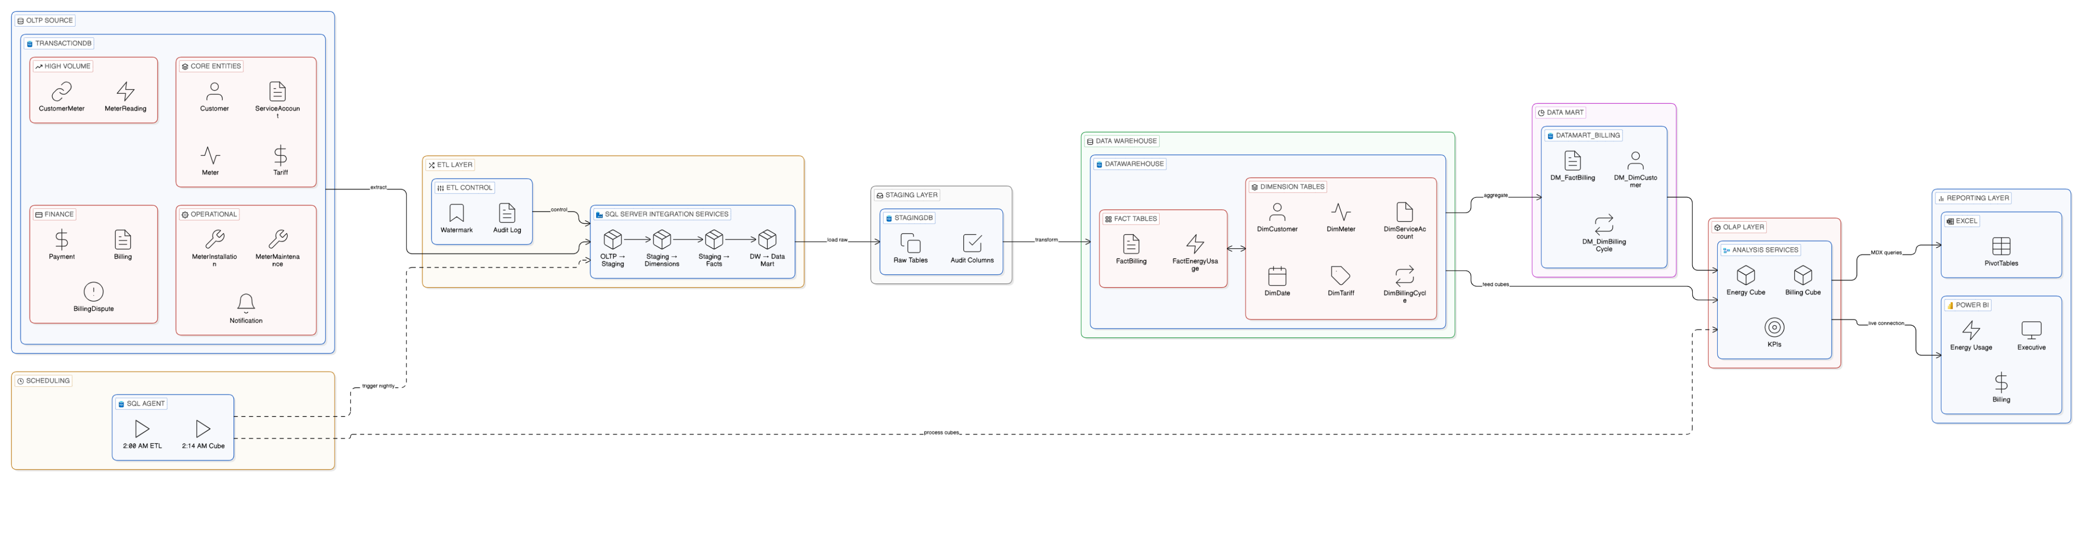
FULL STACK ARCHITECTURE

Slide 6
HOW THE SYSTEM WORKS
OLTP Source: EnergyUtility_TransactionDB (12 tables, ~393K rows)
Data Warehouse: Star schema, 6 dims + 2 facts, SCD-2
Data Mart: EnergyUtility_DataMart_Billing (finance-optimized)
ETL: 4 SSIS packages with stored-procedure architecture
SSAS: 2 multidimensional cubes, 15+ MDX calculated members
Dashboard: Excel PivotTables + Power BI live connection
Scheduling: SQL Server Agent — full pipeline at 2 AM nightly

Slide 7

OLTP Source Database
(Core Entities):Customer (1,000 rows) — CustomerType drives tariff eligibilityTariff (5 rate plans) — peak/off-peak pricingServiceAccount — account-tariff link per customerMeter — Smart, Analog, Digital devices
(High-Volume & Finance):
MeterReading — 365K rows, IsPeak + AnomalyFlagBilling — monthly invoice per account, 5 status lifecyclePayment — multiple partial payments per billBillingDispute — Open → Resolved workflow

Slide 8
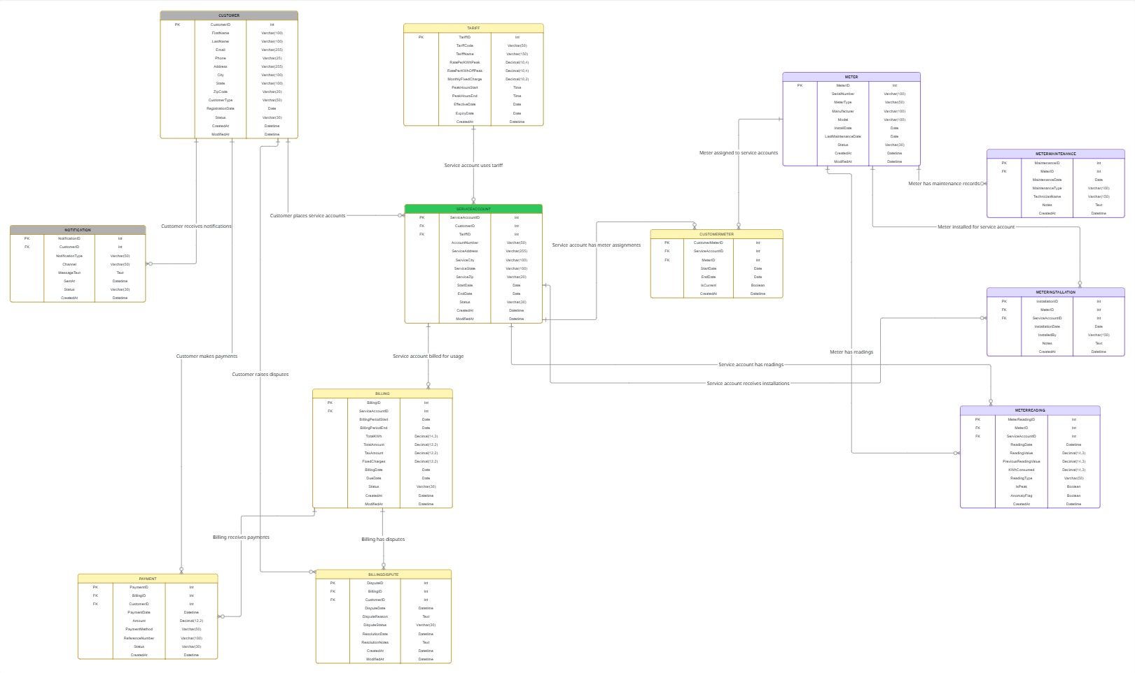
OLTP SOURCE ERD

Slide 9
Data Warehouse
Star schema, 6 dimensions, 2 fact tables, SCD-2 on Customer, Account, and Meter.
DimDate (4,383 rows, 2019–2030) pre-populated — DateKey = YYYYMMDD integer for fast joinsDimCustomer / DimServiceAccount / DimMeter — SCD Type 2 with EffectiveDate, ExpiryDate, IsCurrentDimTariff — SCD Type 1 (rates are reference data, history not needed)FactEnergyUsage — grain: one row per MeterReading (~365K rows); measures: KWhConsumed, EnergyCostFactBilling — grain: one row per account per billing cycle; MERGE handles status change updates

Slide 10
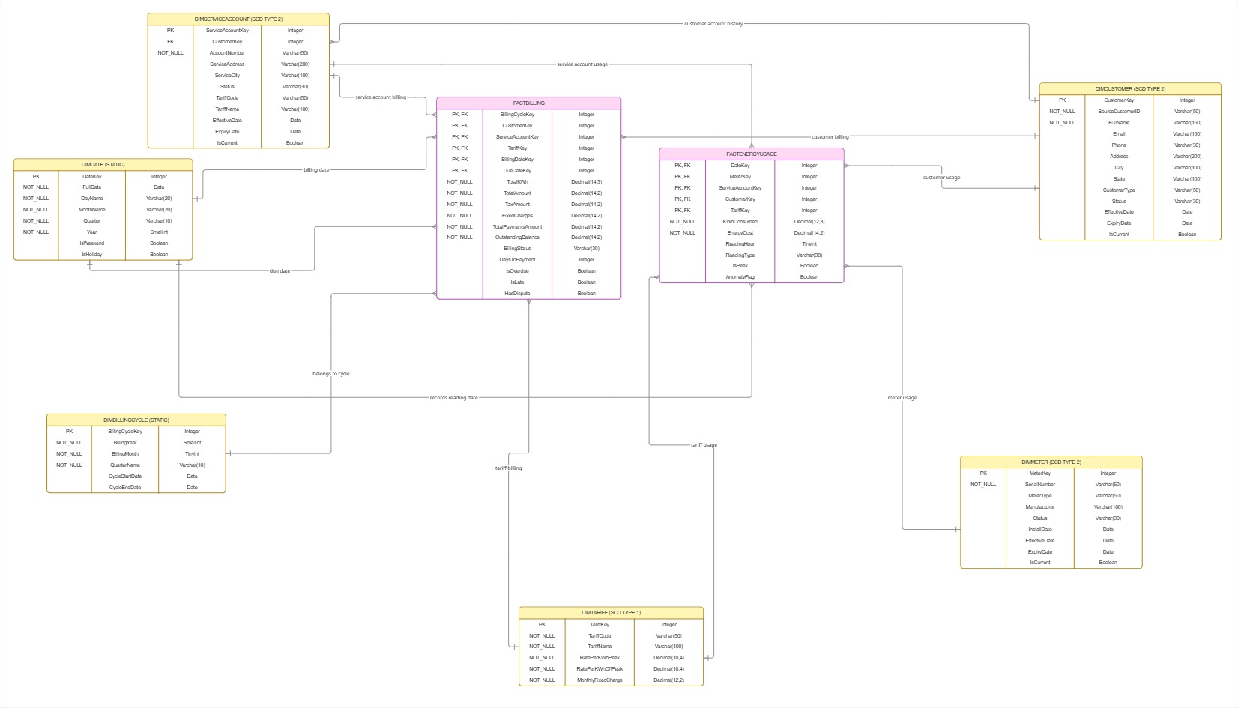
DW SCHEMA

Slide 11

BILLING DATA MART
Finance-optimized subset of the DW — most queries are single-table scans with zero joins.
DM_DimCustomer — flat current-state only (no SCD history rows)DM_DimBillingCycle — self-contained copy so mart needs no cross-database joinsDM_FactBilling — CustomerType, City, and State denormalized inlineFinance query "overdue bills by type this quarter" = single table scan, no joins required

Slide 12

SSIS ETL PIPELINE
Four packages, stored-procedure architecture, watermark-driven incremental loading.
All ETL logic lives in SQL stored procedures — SSIS is a thin orchestration layer. Set-based SQL is 10–20× faster than row-by-row Data Flow Tasks for this domain.
Package 1 (OLTP → Staging): Watermark extract — 12 tables via usp_Stage_* procs, RunID audit trail
Package 2 (Staging → Dims): SCD-2 MERGE — expire old row, insert new version for Customer, ServiceAccount, Meter
Package 3 (Staging → Facts): FactEnergyUsage INSERT + FactBilling MERGE on SourceBillingID
Package 4 (DW → Data Mart): MERGE into DM_FactBilling with denormalized CustomerType + City

Slide 13

SSAS OLAP CUBE
Two cubes, 15+ MDX calculated members, and 3 KPIs give analysts millisecond query response.
The SSAS project contains two multidimensional cubes sharing six dimensions (Date, BillingCycle, Customer, ServiceAccount, Tariff, Meter). MOLAP storage pre-aggregates all data so Excel and Power BI queries return instantly.
Calculated measures include:Peak Usage % = Peak KWh / Total KWhCollection Rate % = Payments Collected / Billed AmountKWh MoM Change % using PARALLELPERIODRevenue YTD using SUM over YTD billing cyclesOverdue Rate %, Dispute Rate %, Avg Days To PaymentKPIs (traffic lights): Collection Rate > 90% = green; Overdue Rate < 10% = green; Dispute Rate < 5% = green

Slide 14
DASHBOARDS
report pages covering consumption, billing, risk, and executive KPIs — all connected live to the SSAS cube.
Excel workbook :
Executive Summary — 6 KPI metric tiles, monthly revenue trend, consumption by segment
Energy Consumption — daily trend, peak/off-peak split, top-10 accounts, anomaly heatmap
Billing & Collections — revenue waterfall, status distribution, monthly KPI table with conditional formatting
Disputes & Risk — dispute rate trends, outstanding balance by city, high-risk customer list

Slide 15
DASHBOARDS
Power BI (2 report files):
EnergyUsage_Report.pbix — consumption analysis, peak load, geographic heatmap
Billing_Report.pbix — KPI visuals with traffic lights, collections funnel, risk matrix scatter

Slide 16
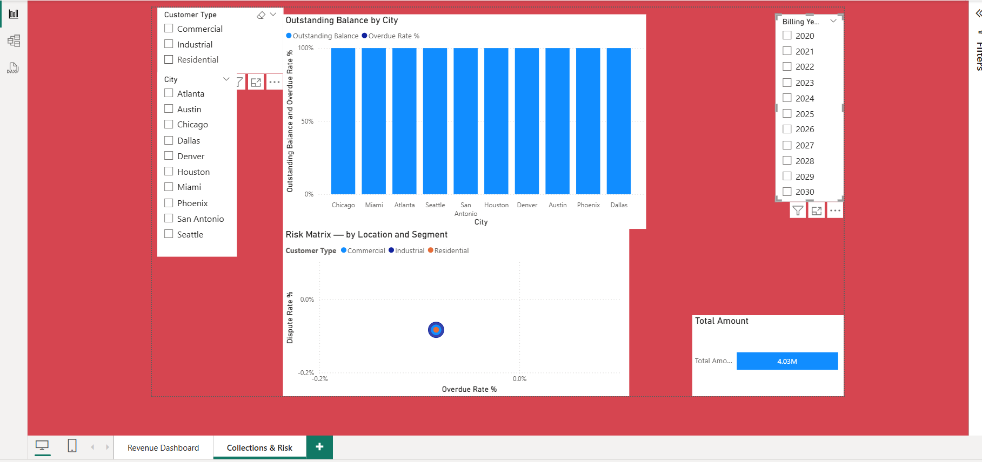

Slide 17
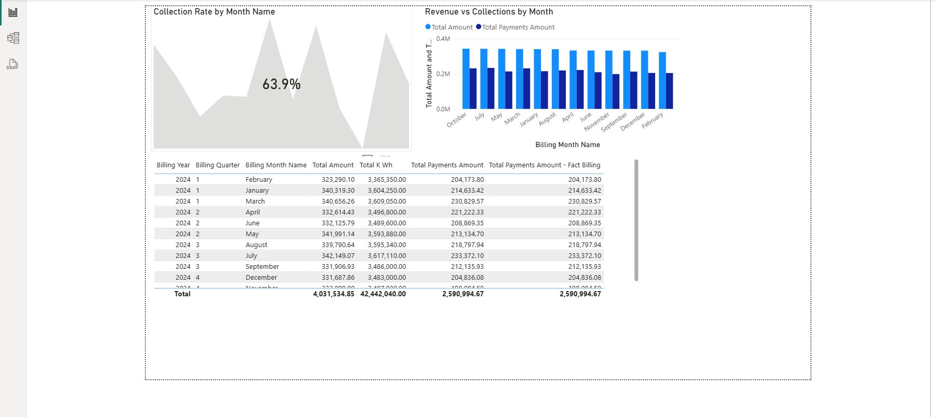

Slide 18
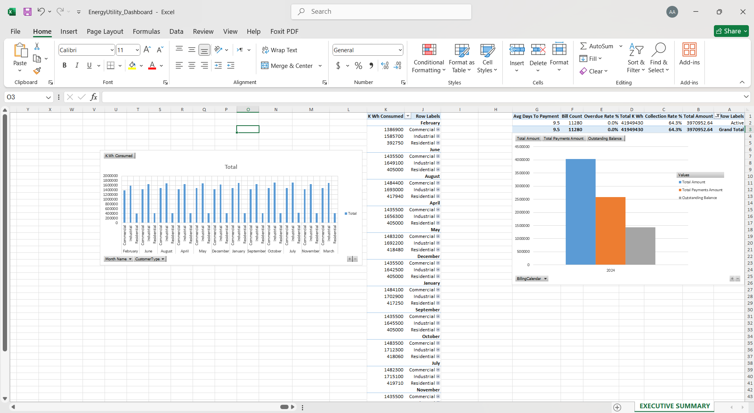

Slide 19

AUTOMATION & SCHEDULING
SQL Server Agent runs the full pipeline nightly — from raw transactions to live dashboard with no human intervention..
An automated nightly chain ensures data is always fresh when the team arrives in the morning.

Slide 20

NEXT STEPS
-The core architecture is complete. These actions move it to production-ready:
Production data volume: Increase seed data to 10+ years and test SSAS partition strategy (one partition per month for FactEnergyUsage)
Real meter data integration: Replace seed data with actual AMI/smart meter feeds via a CSV-to-OLTP SSIS package
Power BI Service deployment: Configure On-premises gateway, publish reports to Power BI Service, set up row-level security per customer type
Executive reporting: Add Overdue + Dispute Rate KPI tiles to the Executive Summary sheet; configure email alerts in Power BI when thresholds breach

Slide 21


THANK YOU

